Slide 1
Execute k6 scripts on cloud

Slide 2
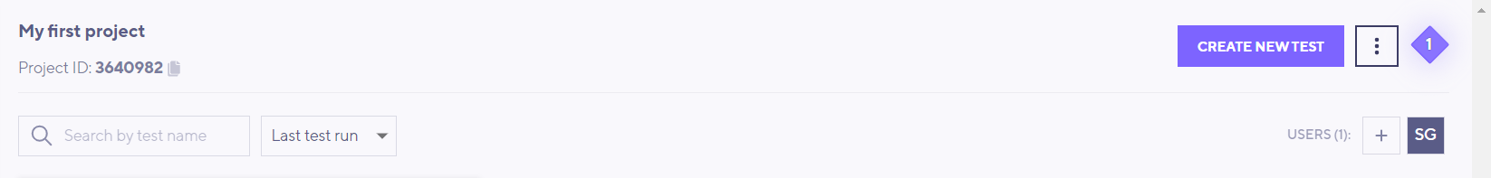
Setup K6 Cloud
Open the below website
https://app.k6.io/account/login
Create account and login into the application

Slide 3
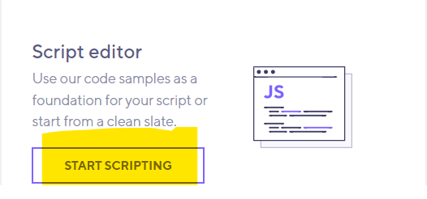

Execute K6 scripts on cloud
Click on “Create New Test”
Click on Start Scripting button
Change any configuration if required and click on “Create and Run”
The load tests will be triggered in the GUI mode

